Slide 1
Digital Medicine

Slide 2
What has been happening in the field of medicine?
While digital forces(computers/telecommunication and control) have been “Schumpetering” the world, medicine has been the last frontier. At a larger plane this is something that was natural given the intrusive nature of medicine.
Some advances are:
-Telemedicine
-Sensors
-Automated pathological testing
…..

Slide 3
4 major forces are
Genomics
Imaging
Wearables
Electronic Health Records

Slide 4
Genomics

Slide 5
History
Charles Darwin-1859-Origin of Species
Gregor Mendel-1866-Pea experiment
Francis Galton(Eugenics)-1905
Walter Sutton and Theodore Boveri-1920
Thomas Hunt Morgan-fruitfly
James Watson and Francis Crick-1953 described the DNA

Slide 6
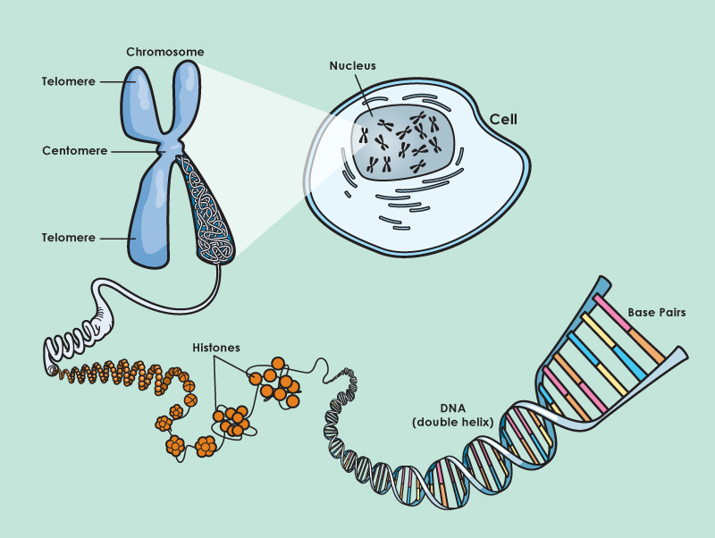
DNA – genetic blueprint
Deoxyribonucleic acid (DNA)
Located in the nucleus
rapped up in structures called chromosomes.
46 Chromosomes -23 Pairs in every cell

Slide 7
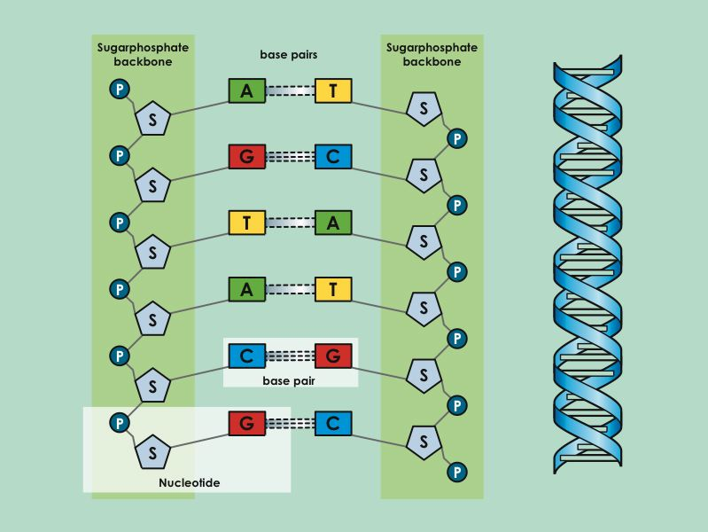
DNA is made of segments called Nucleotides
The building blocks of DNA are nucleotides.
Each nucleotide has a sugar , a phosphate and a nitrogen base ,
, or
There are 4 different nitrogen bases in DNA and they can vary from one nucleotide to the next
The alternating bases provide the CODE
S
P
A
G
T
C

Slide 8
In humans, the DNA molecule in a cell, if fully extended, would have a total length of 1.7 metres. If you unwrap all the DNA you have in all your cells, you could reach the moon ...6000 times!

Slide 9
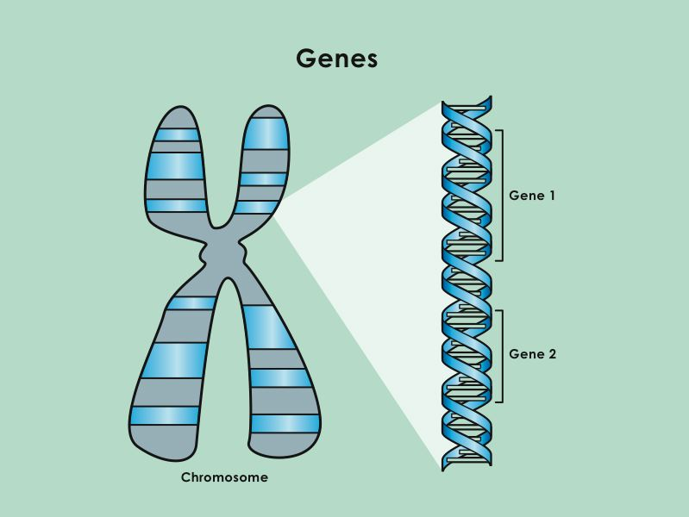
What is a gene?
A part of the DNA that codes for a protein.
Not all the DNA codes for proteins.
30,000 genes in the human genome.

Slide 10
Genetic Alterations

Slide 11
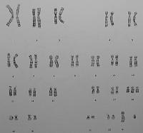
Abnormal Number of Chromosomes
Trisomies -3 copies rather than 2 copies of a chromosome
Monosomies – 1 copy rather than 2
3 pairs of chromosome 21

Slide 12
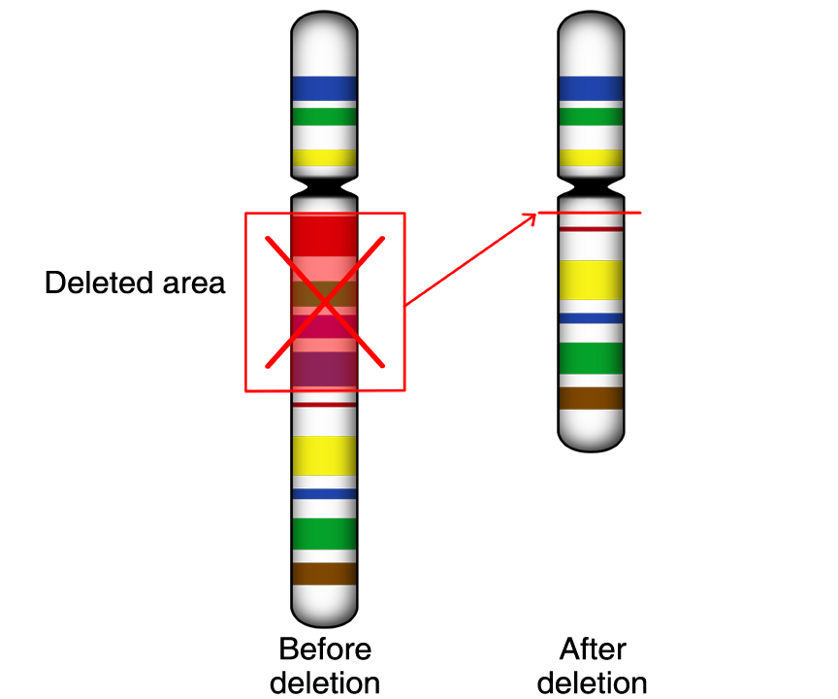
Changes in DNA
Deletion: a section is missing
Translocation: a section shifts from one chromosome onto another
Inversion: a section gets snipped off and reinserted the wrong way around.
Single gene changes: a small nucleotide change in a segment of the DNA that codes for a gene

Slide 13
Inheritance

Slide 14
Inheritance
All cells (apart from egg/sperm cells) have 46 chromosomes (23 pairs).
One copy of each pair is inherited from the mother and the other from the father.

Slide 15
Sex Cells
Sperm and egg cells only have half the number of chromosomes (23)
At fertilization the nucleus of a sperm unites with the nucleus of an egg to produce a complete set of chromosomes (46).

Slide 16
Inheritance
Dominant Inheritance
One copy of a gene is dominant over the other
Recessive Inheritance
A gene is expressed only when both copies are the same
X-Linked Inheritance
A genetic feature is carried by the X chromosome (females XX, males XY)

Slide 17
Sex Chromosome Abnormalities
Male: XY
Female: XX no Y
Errors:
only 1 X
Extra X or Y
XXY, XXXY

Slide 18




Recessive Inheritance
Unaffected ‘Carrier’ Father
Unaffected ‘Carrier’ Mother
R
r
R
r
R
R
r
R
R
r
r
r
Unaffected 1 in 4 chance
‘Carrier’ Unaffected 1 in 4 chance
‘Carrier’ Unaffected 1 in 4 chance
Affected 1 in 4 chance
R = A dominant genetic feature
r = a recessive genetic feature
Unaffected ‘Carrier’
Unaffected
Affected

Slide 19
X-linked Inheritance
Unaffected Father
Usually Unaffected ‘Carrier’ Mother
X
Y
X’
X
X
X
X
Y
X
X’
X’
Y
Unaffected ‘Carrier’ DAUGHTER 1 in 4 chance
Unaffected DAUGHTER 1 in 4 chance
Unaffected SON 1 in 4 chance
Affected SON 1 in 4 chance
X’ =A genetic feature carried on the X chromosome
Unaffected ‘Carrier’
Unaffected
Affected

Slide 20
Examples of Conditions Caused by DNA Changes
Abnormal number of chromosomes
Down’s syndrome, Edwards syndrome,
Deletion
Cri Du chat, Williams syndrome
Sex Chromosome Abnormalities
Turner syndrome, Klinferlter’s syndrome
Single Gene Mutations
Cystic Fibrosis, Sickle Cell anaemia

Slide 21
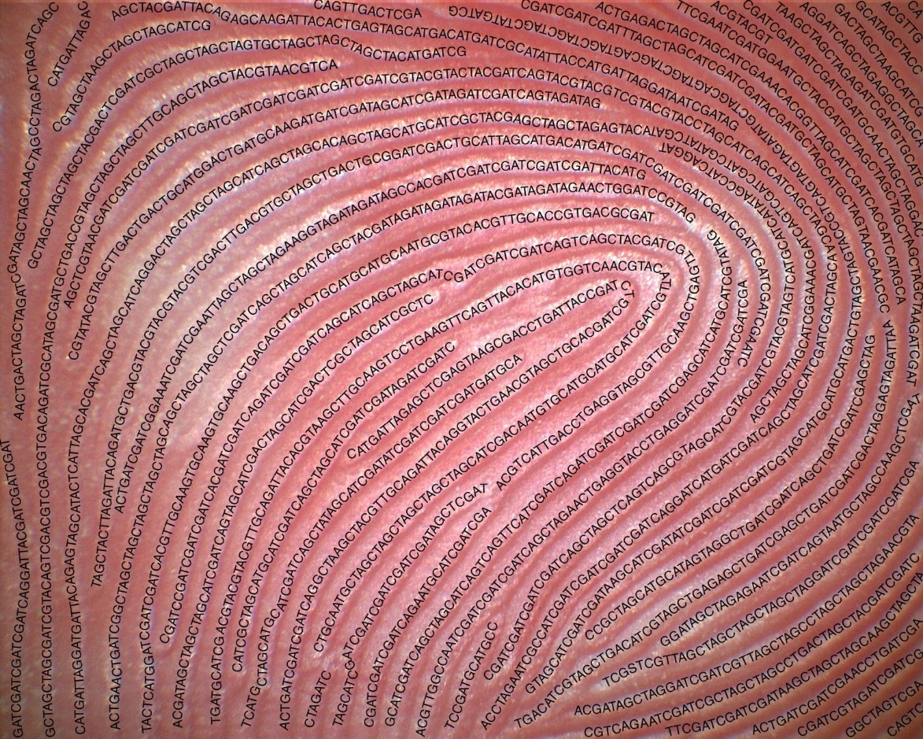
Genetic Testing & Profiling

Slide 22
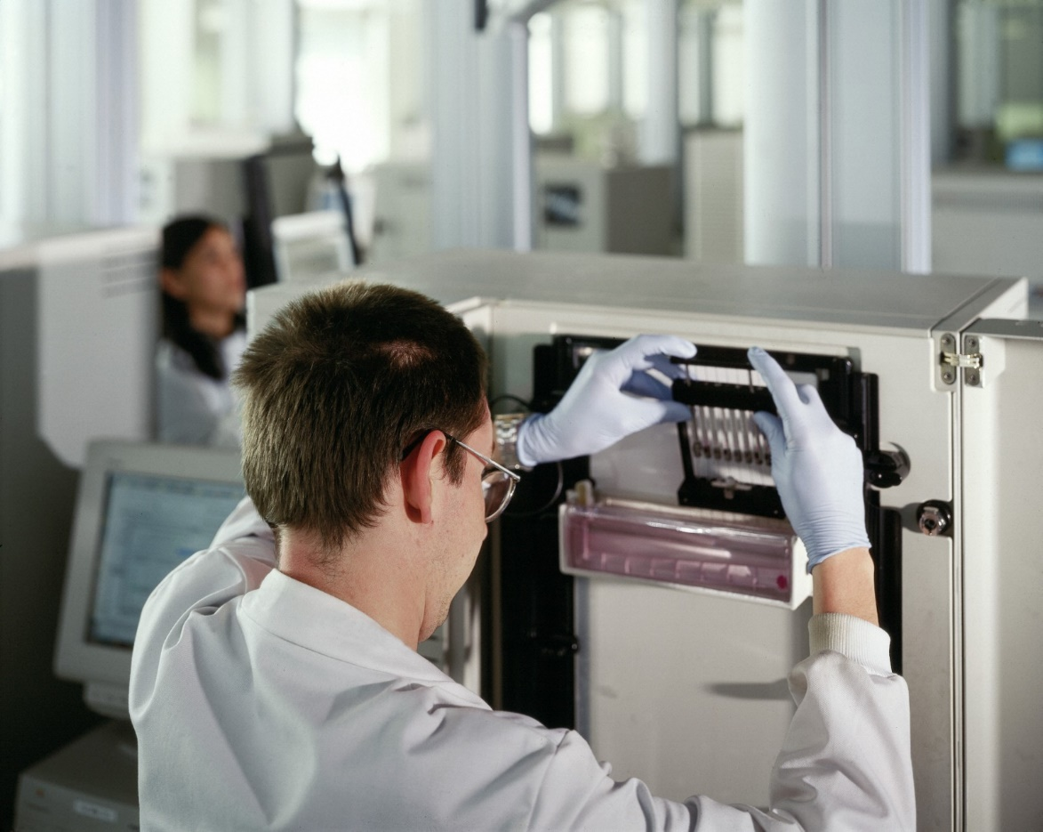
Genetic Profiling
Take a sample of cells (blood, hair root)
Extract the DNA from cells
Cut up the DNA
Separate the DNA fragments
Analyse the DNA fragments

Slide 23
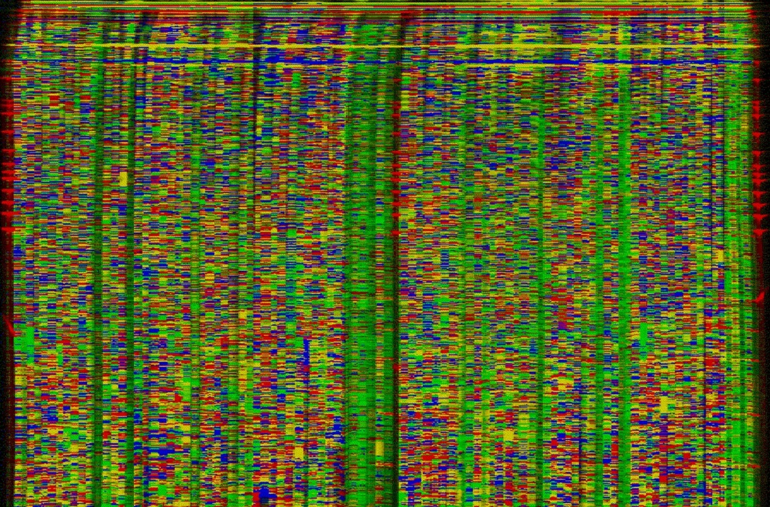
The output from an automated DNA sequencing machine used by the Human Genome Project to determine the complete human DNA sequence.

Slide 24
Genetic Testing for Specific Conditions
Take a sample (blood/amniotic fluid, mouth swab)
Use staining of chromosomes to locate any chromosome abnormalities
or use matching DNA sequences or antibodies to detect gene abnormalities

Slide 25
Types of Tests
Diagnostic | Used to confirm a diagnosis based on physical signs
Predictive | Used to detect gene mutations associated with disorders that appear later in life
Carrier Identification | Used by people with a family history of recessive genetic disorders
Prenatal | Used to test a foetus when there is risk of bearing a child with metal or physical disabilities
Newborn Screening | Used as a preventative health measure once the baby is born
Forensic testing | Used to identify an individual for legal purposes
Research testing | Used for finding unknown genes and identifying the function of a gene

Slide 26
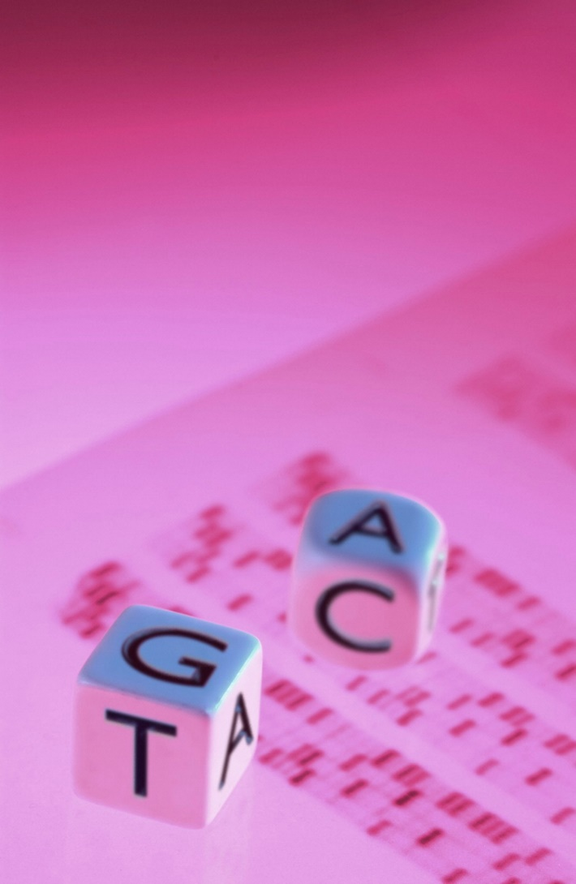
Genetic Testing and profiling is making it possible to assess disease risk from looking at a persons DNA.
The pattern of diagnosis and treatment of disease may be replacement by a new pattern of predicting a disease and preventing it.

Slide 27
Uses of Genetic profiling
Revolutionize the process of drug screening and discovery
Improve Cancer classifications
Identify the genes, cells and pathways involved in a process such as aging or tumorigenesis
Determine the effectiveness of an innovative therapy
Test toxicity without animals

Slide 28
Physical change in DNA
Through Liposomes or fatty spheres
Nanoballs
Adenovirus
Sympathetic Viruses(Celera Genomics-Craig Venter)
Stem Cells(United Therapeutics)

Slide 29
New technologies
RNAi-RNA interference is capable of turning off specific genes by blocking their mRNA
Cell therapies-Cloning our own body parts to implant them in our body
Gene Chips-”Do it yourself” gene watching
Somatic Gene Therapy-Changing our non-reproductive cells by injecting new DNA

